Slide 1
Emergency Response System JishinSensa - 自信センサ
by:
Edvaldo Santos
Helio Nakazato
Hirley Dayan

Slide 2
OVERVIEW
Emergency response solution for detecting city disaster events based on sensor data and social networks publications.

Slide 3
SOLUTION COMPONENTS
Hardware components of the solution:
1 Qualcomm Dragonboard 410c board
1 Arrow Linker Mezzanine Card Kit with:
1 temperature sensor
1 tilt sensor
And 1 LDR sensor

Slide 4
SOLUTION COMPONENTS
Platform components of the solution:
AWS IoT Platform
Twitter
Software components of the solution:
Linaro, CoreOS and Debian operating systems
Python services on the device and some backend services
NodeJS on thee Graphical User Interface

Slide 5
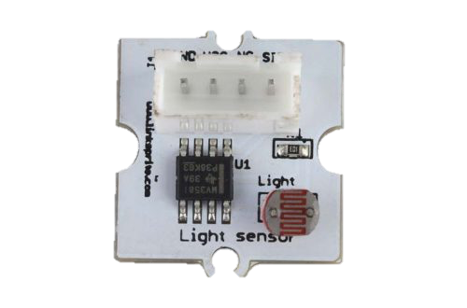


SOLUTION OVERVIEW

Slide 6
PROTOCOLS
API TweePy
HTTP
Linux processes
MQTT
MQTT
MQTT over WebSocket

